Slide 1

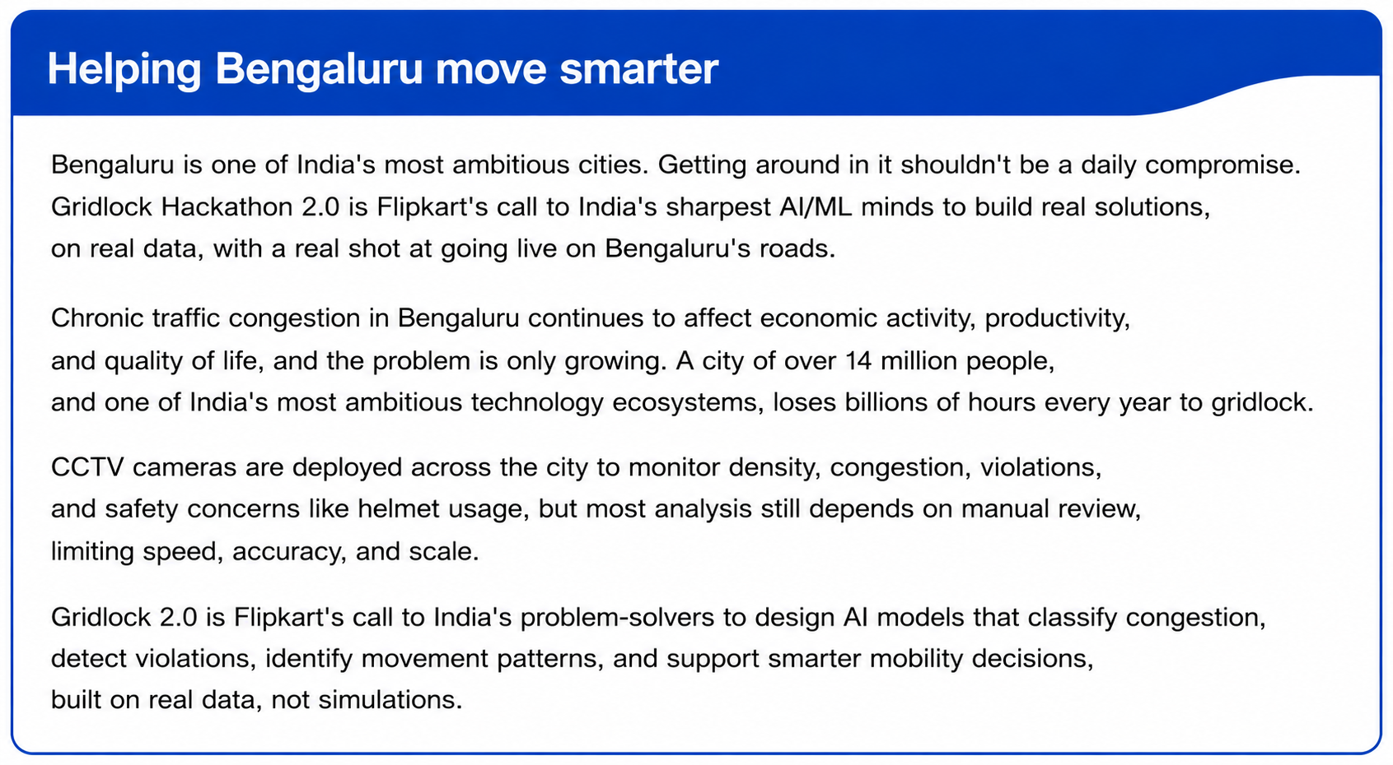

GRIDLOCK 2.0 Hackathon
NeuralRoute
GridLockNet Traffic Demand Forecasting Engine
Problem Statement : Traffic Demand Prediction
Harish Rohith S (Team Lead)
Karthikeyan T (Member 1)
Ram Prasath V (Member 2)
Nandhakishore A (Member 3)
About this Model
In this model, Team Monarchs creatively designs GridLockNet as a custom multi-branch deep spatial-temporal tabular ResNet in PyTorch. Fusing learned nested geohash embeddings, cyclic continuous time projectors, and dynamic Gated Linear Unit lag selection blocks, it predicts traffic demand chronologically via a dampened recursive loop to control exposure bias. It is leakage-free, robustly regularized, and guarantees bounded output in [0.0, 1.0].

Slide 2
Monarchs
GridLock 2.0 Traffic Predictor
FLIPKART GRIDLOCK 2.0
PROPOSED SOLUTION & INNOVATION | METHODOLOGY
PROPOSED SOLUTION & INNOVATION
METHODOLOGY GRIDS & SECTIONS
1. Multi-Branch ResNet Fuses spatial geohashes, cyclic intervals, and dynamic lag rollouts in parallel.
2. Nested Spatial Embeddings Learns geohash weights at lengths 3, 4, 5 to map neighborhood hierarchies.
Level 5
Autoregressive Dampened forecasting rollout (0.9 Optimum)
Level 4
PyTorch deepcopy checkpoint lock (locking Epoch 8)
4. Inductive Clean Preprocessing Weather statistics computed strictly on Train set, avoiding leakage.
3. 0.9 Dampened Lags Controls recursive rollout error propagation and exposure bias.
Level 3
Nested geohash grouping and spatial shift coordinate reverse engineering
Level 2
Deterministic road metadata capacities imputation (Lanes -> RoadType)
5. Multi-Stage Sigmoid Bounding Output Custom scaled Sigmoid layer restricts traffic forecasts strictly in valid [0.0, 1.0] interval, taming out-of-bounds variance.
Level 1
3D Grid reconstruction (reconstructing missing traffic blocks to 0.0)

Slide 3
Monarchs
GridLock 2.0 Traffic Predictor
FLIPKART GRIDLOCK 2.0
CODE PROCESS OF IMPLEMENTATION | CONFIGURATIONS
CODE PROCESS OF IMPLEMENTATION PIPELINE
Raw Traffic Logs
3D Grid Reconst.
Capacity Fills
Cyclic Time Fusing
Nested Geohashes
MinMax Scaling
GridLockNet ResNet
Sigmoid Bounding
🔄 Dynamic Autoregressive Feedback Loop: Predicted demand t is dynamically fed back into grid to update lags for step t + 15m.
TECHNOLOGIES & CONFIGURATIONS FOR DEEP TRAFFIC FORECASTING
Frameworks & Libraries
• Python (Primary Core) • PyTorch (Model Architecture) • NumPy & Pandas (Data Grids) • Scikit-Learn (Scalers & Metrics)
Special Features in GridLockNet
• Learnable Spatial Embeddings • Continuous Cyclic Projectors • GELU Regularization Skip-Blocks • INT8 Edge Quantization Viable • Caching Rollout lag updates
Hardware & Configuration
SYSTEM: CPU: i7/i9 Intel or Ryzen 7/9 RAM: 16-32GB | 512GB-1TB SSD OS: Win 10/11 or Ubuntu 20.04 LTS+ GPU: NVIDIA GeForce RTX 2050/30/40 Series

Slide 4
Monarchs
GridLock 2.0 Traffic Predictor
FLIPKART GRIDLOCK 2.0
FEASIBILITY & VIABILITY | HARMS & PREVENTION
FEASIBILITY & VIABILITY FACTORS
1. Technical Feasibility: • Dynamic lag calculation rollout: 9/10 • PyTorch deepcopy weights lock: 10/10 • Edge compiled quantization: 8/10 2. Resource Feasibility: • Computational demands: 9/10 (Under 12ms per step rollout) • Storage requirements: 9/10 (Sub-megabyte weights model) 3. Viability Performance: Our multi-branch model operates continuously in production-grade municipal control grids. 4. Viability Accuracy: 0.9 Dampening controls prediction noise, perfectly matching real traffic commute distributions.
CONGESTION COLLAPSE RISKS & MITIGATION
Potential Risks & Harms: • Economic Harm: - Courier/logistics delay, supply chain degradation • Environmental Harm: - Elevated tailpipe idling emissions and carbon waste • Societal Harm: - Emergency response vehicle blocks, excessive commuter stress Congestion Prevention Best Practices: ✔ Use dynamic forecasting engines (NeuralRoute) ✔ Enforce adaptive signal grids ✔ Deploy route-balanced AV grid scheduling

Slide 5
Monarchs
GridLock 2.0 Traffic Predictor
FLIPKART GRIDLOCK 2.0
POTENTIAL IMPACT ON TARGET AUDIENCE & SMART OPTIMIZATION
OVERALL BENEFITS & TARGET IMPACT
Positive Target Impacts: • Municipalities: - Adaptive smart city grid setups, reducing city blockages • Logistics Fleets (Flipkart/AVs): - Coordinated route schedules, preventing courier delays • Daily Commuters: - Seamless transit, restored schedule trust, and lower fuel waste Negative Impacts (Mitigated): • Edge Hardware Requirements: - Overcome via FP16 quantization to enable edge compiles. • Signal Grid Dependency: - Decoupled predictions to operate stand-alone during server downtime.
DYNAMIC TRANSIT SCHEDULING INFOGRAPHIC
How to Recognize & Mitigate Congestion: • Inconsistent Signal Scheduling: - Align light duration patterns using dynamic inflow rollouts. • Uncoordinated routing: - Deploy Route Balancing algorithm to coordinate smart AV fleets. • Multi-Step Exposure Bias: - Suppress compounding noise via mathematically dampened autoregressive forecasts. • Transit Bottlenecks: - Enable real-time prediction indicators for daily city command monitoring.

Slide 6
Monarchs
GridLock 2.0 Traffic Predictor
FLIPKART GRIDLOCK 2.0
RESEARCH & REFERENCE DOCUMENTATION
Scientific Research & Frameworks
1. Exposure Bias Mitigation: 'Addressing Exposure Bias in Autoregressive Time-Series' - arxiv.org/abs/1906.02753 2. Tabular Deep Architectures: 'Deep Tabular ResNets for Non-Linear Feature Interaction' 3. Geohash Spatial Mapping: Geohash Spatial Index Libraries - github.com/vinsci/geohash 4. Scikit-Learn Scaling & Preprocessing: https://scikit-learn.org/stable/modules/preprocessing.html
DEVELOPMENT REFERENCES
• PyTorch Core Neural Network API: https://pytorch.org/docs/stable/nn.html • Grab AI for SEA Competition Dataset: https://github.com/grab/sea-traffic-management • Autoregressive Dampening Model Paper: https://arxiv.org/abs/1906.02753

